Slide 1




RIVER REVERSALS AND THE METABOLIC REGIMES OF FLORIDA’S SPRINGS
Samantha T. Howley¹, Yusueng Shin¹, Matt Cohen²
School of Natural Resources and Environment (1)
School of Natural Forest, Fisheries, and Geomatic Sciences (2)
University of Florida | IFAS, Gainesville, FL 32611

Slide 2
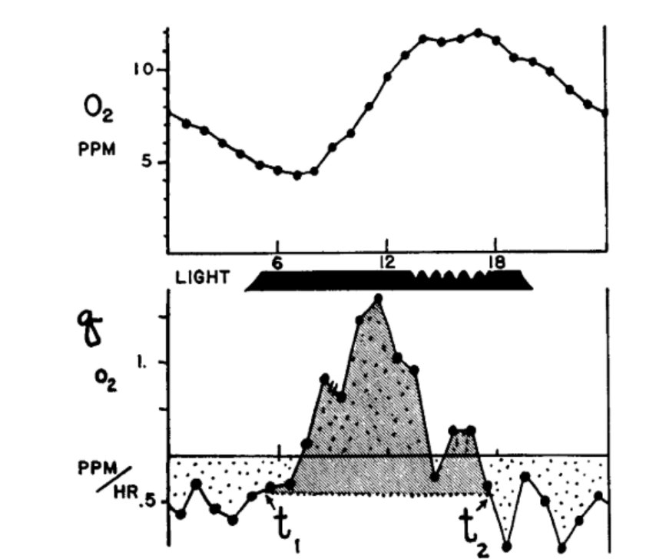

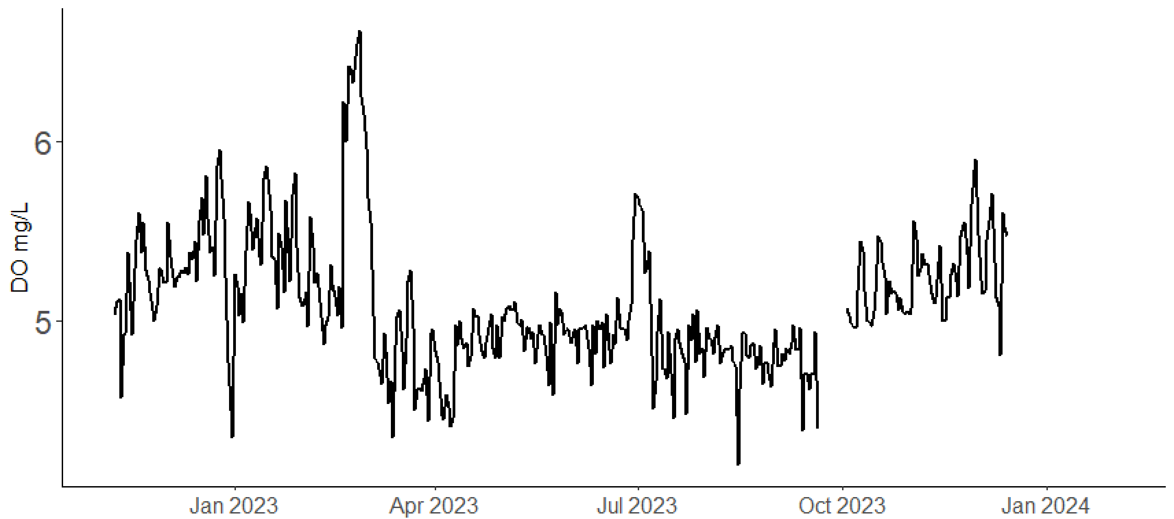
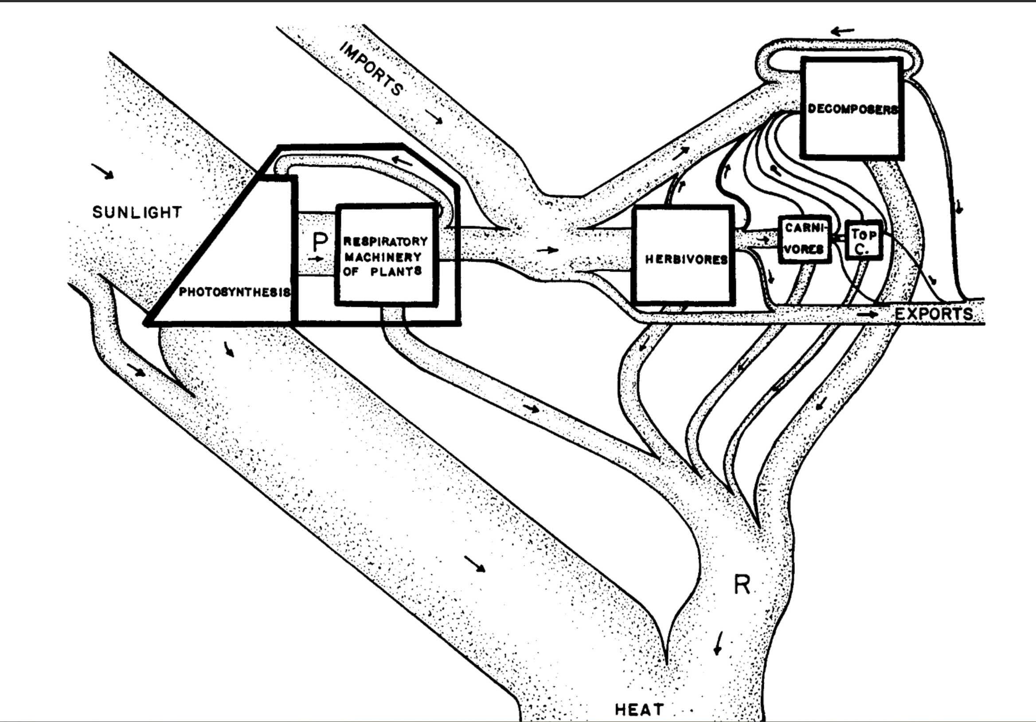

Metabolic Regime: the productivity of an ecosystem over a study period.
Stream metabolism: the energy flow through out an ecosystem via gross primary
Productivity (GPP) and ecosystem respiration (ER).
Gross Primary Productivity (GPP): total photosynthesis; producing oxygen.
Net Ecosystem Productivity (NEP) = GPP-ER
Ecosystem Respiration (ER): total respiration; consuming oxygen.
Primary Production of Flowing Waters (1956), HT Odum
Notes:
Before I begin, the metabolic regime of flowing waters is a stream or rivers productivity over a study period.
But it’s first found by modeling a stream’s daily metabolism
Stream metabolism is the energy flow through out an ecosystem via
gross primary productivity, GPP, organisms producing oxygen and
Ecosystem respiration, ER, consuming oxygen
Therefore, stream metabolism models estimates productivity by tracking the hourly changes in dissolved oxygen
These photos are from the classic publication, the Primary Production of Flowing Waters where HT Odum researched the metabolic regime of… North Florida’s springs ☺
Historically, modeling stream metabolism was challenging. Each of these little dots was hand sampled.
Classic stream metabolism literature only encompassed a few days and observed normal, undisturbed conditions.
In there present, where high-frequency, durable DO sensors are available, stream metabolism experiments are less-energy intensive, allowing users to explore streams metabolism under non-disturbed and disturbed periods.

Slide 3










Influences on stream metabolism:
Energy:
Inputs:
Seasons
Light Availability
Flow Velocity
Organic Matter
Canopy Cover
N-P
Biomass density
Nutrients
Recalcitrance
Temperature
Depth (stage)
Disturbance
Bernhardt et al., 2019; Hall et al., 2015; Julian et al., 2008; LeRoy Poff et al., 1997
Acuña et al., 2004; Fuss & Smock, 1996;Meyer & Edwards, 1990; Mulholland et al., 2001
Notes:
Stream metabolism, and therefore stream metabolic regime, is dictated by a multitude of factors such as canopy cover, disturbance, and nutrient concentrations but in my opinion, light, OM quality/quantity, and flow are the majoring determining factors.
Light powers photosynthesis, OM is influential for ER, and flow velocity determines the export of solutes and biomass density.

Slide 4

Welcome to North Florida’s Springs
Odum, 1956; 1957
Notes:
Which brings me to my study sites, North Florida springs! A terrible place to do fieldwork!
Due to the Upper Florida aquifer (the UFA) discharging groundwater to the springs at a near constant rate and at a near constat temp of 73 degrees F year-round, FL’s springs have some of the clearest, stable and most productive waters in the world
When HT Odum studied N FL springs, specifically Ichetucknee and Silver river, he described productive, clear, stable-flowing, waters with a distinct upstream and downstream.

Slide 5

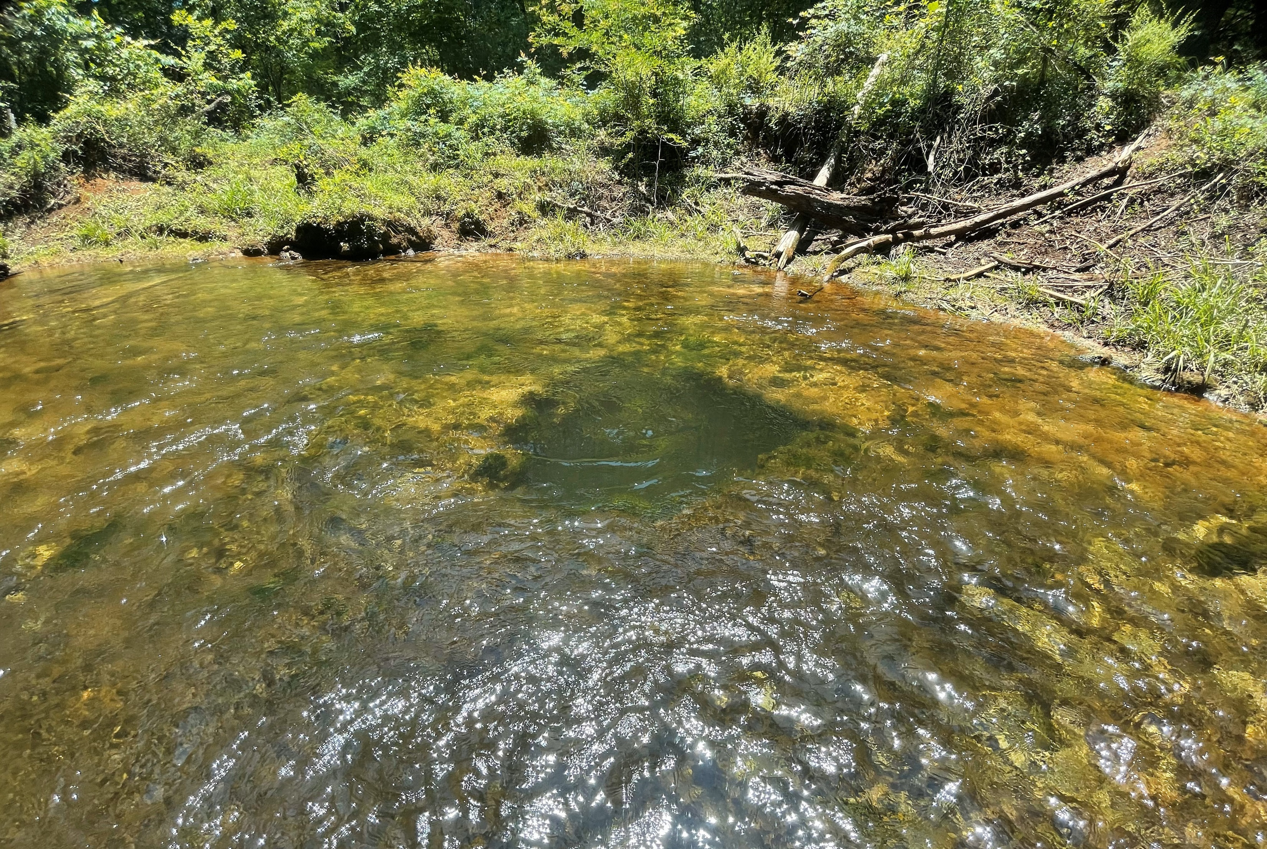
…but they don’t all look like that…
Ichetucknee Blue Hole
Allen Mill Pond
Notes:
An although that is true for Ichetucknee and Silver River, that does not apply to all N Fl springs. Most reaches are much shorter (~500m), and their water is more green than blue

Slide 6


…and they have site-specific flow regimes…
Gilchrist Blue Spring
Notes:
Nor do they all have stable flow regimes. Although these springs don’t experience drought, they do flood…

Slide 7






River reversals (backwater floods)
River Reversals (RR)
High stage events
Brown out
Flow reversal
Increasing Disturbance Magnitude
Hensley et al. 2017
Normal
Notes:
Most of Florida’s springs discharge into a downstream blackwater river.
Spring vents are located at higher elevation with the river-spring confluence at lower elevation.
After prolonged precipitation (conditions that would cause flooding), the river’s water level will rise, minimizing the elevation difference between the spring and the river
In all situations, the river will block or hinder spring discharge raising the stage.
But in the most severe scenarios, a backwater effect happens, meaning, the river’s elevation can even exceed the springs causing the river to flow into the springs.
A high stage event occurs when the river acts like dam. Spring discharge is inhibited, water is accumulated within the run, and stage increases BUT water clarity is maintained
A brownout occurs when the river elevation exceeds the spring-run. River water will enter and mix with spring water, and flow is stopped. Water is clarity is reduced.
For flow reversals, the river exceeds the spring vent and will flow into the run, displacing spring water. In this situation, the headwaters will have switched, and flow is backwards.

Slide 8
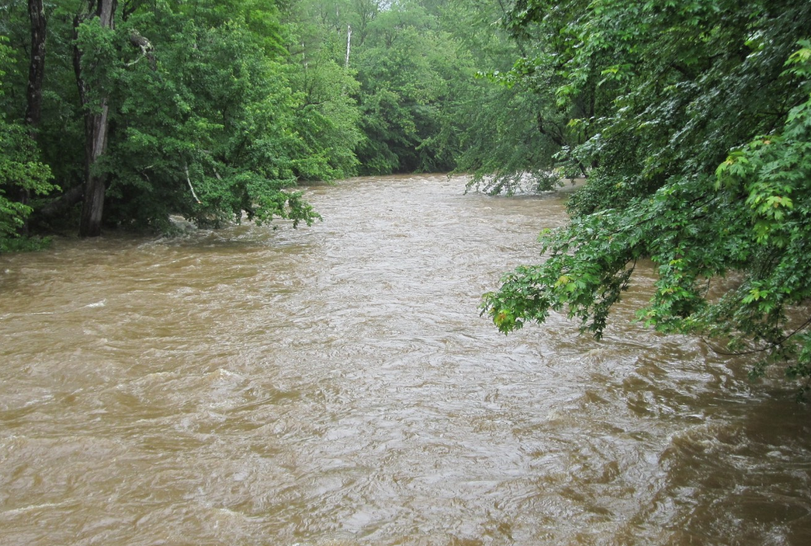




Spring-runs do not experience bed scour during floods.
Bed Scour
Gilchrist Blue Springs
Notes:
Typical stream floods and river reversals are similar. They both experience an increase stage and reduced water clarity, but springs do not experience bed scour
In most streams, fast-flowing flood-waters causes bed scour, the physical removal of a stream's benthic material
During a river reversal, flow is diminished so there is no bed scour. The benthos is retained but under meters of water, sometimes blackwater

Slide 9
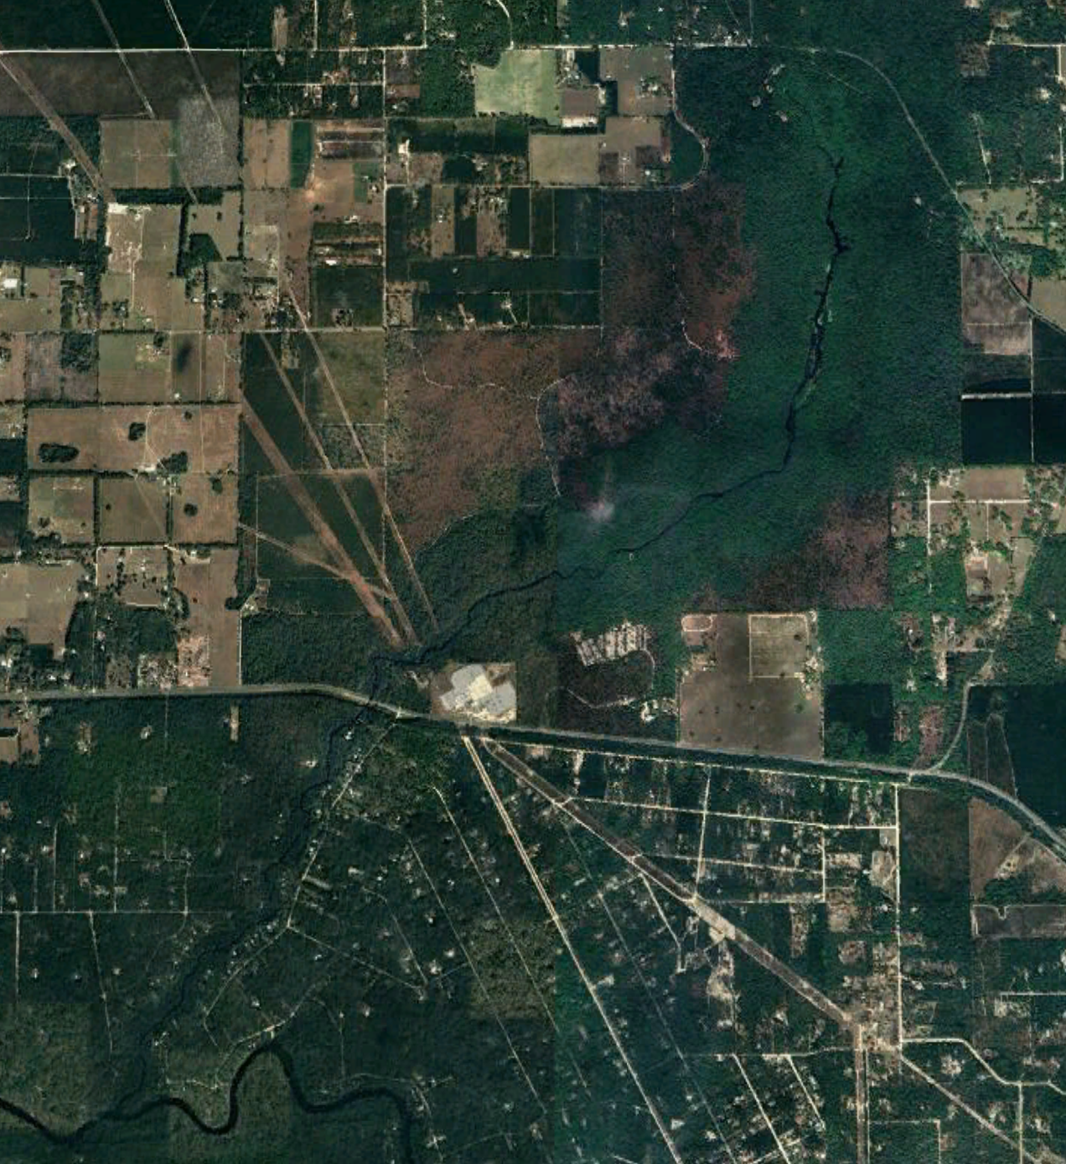




Florida springs belong to a gradient of flow and disturbance regimes.
Ichetucknee River
Gilchrist Blue Spring
Rum Island Spring
Disturbance Regime
distance
Susceptibility to River Reversals:
elevation
Notes:
Florida springs belong to a gradient of flow regimes where some river-reversing with every major rain event , and others rarely ever experiencing a high stage event.
A springs susceptibility to a river reversal is a largely dependent 1) its vent elevation and 2) its proximity to its receiving blackwater river (how long its spring run is)
Ichetucknee river, a spring with a long run, is rarely disturbed and is known for its clear waters and thick mats of macrophytes
but shorter springs that experience a quarter to half the year brown (such as rum island ) tend to have less biodiversity and are murkier

Slide 10

I sought an improved understanding of spring metabolic regimes across a gradient of flow impacts.
What are the metabolic impacts of spring river-reversals, especially in the absence of bed scour?
H1. Spring-run productivity will decline during floods, despite the absence of bed scour
Are springs with greater disturbance frequency less productive than less disturbed springs?
H2. Flood magnitude will be positively correlated with metabolic recovery time and metabolic reduction.
H3. Frequently disturbed springs will have less stable metabolic regimes than rarely disturbed springs.
Notes:
For this project, I sought to understand how spring backwater floods (river reversals and high stage events) impact spring metabolism
Furthermore, I wanted to understand, if and how disturbance influences spring typology. Specifically,…
Are springs with greater disturbance frequency less productive than less disturbed springs?
What are the metabolic impacts of these spring inverted-flood in the absence of bed scour?

Slide 11

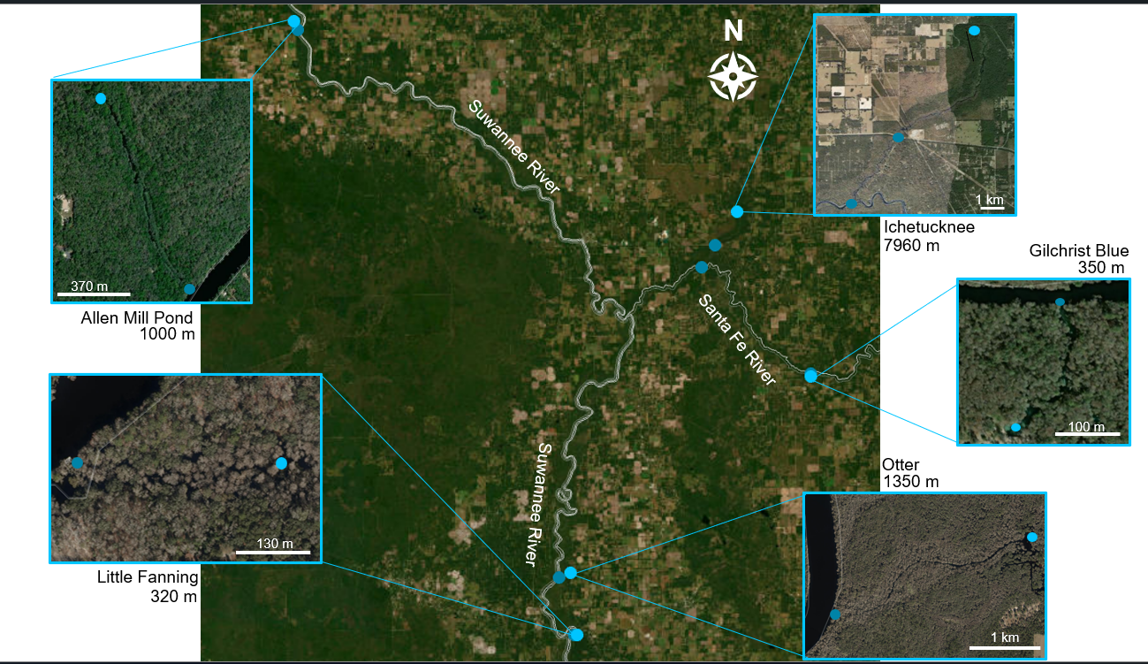
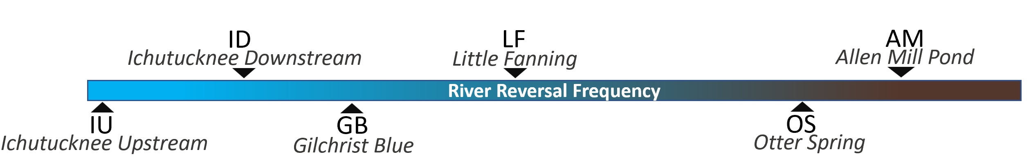
Methods: Study Sites
Two-Station Metabolism
One-Station Metabolism
downstream
Normal
Flooded
upstream
0%
52%
100%
One-station Days
100%
32%
32%
Riley & Dodds et al. 2023; Reichert et al., 2009; Demars et al., 2015
Notes:
To explore my hypothesis, I selected 5 spring-runs spanning a river-reversal frequency gradient including the iconic Ichetucknee river to the frequently reversing Allen Mill Pond; it spends half of the year brown.
I estimated each sites stream metabolism using two-station methods during normal conditions and one-station methods during flooded conditions.
The percentage of “one-station days” is at the bottom. These days do not represent when these sites were river reversed. They represent days where flow was slow, requiring I use one-station methods. My least disturbed site unfortunately had no upstream station requiring I use one-station.
The project is still ongoing, and I began monitoring these sites in late 2021

Slide 12
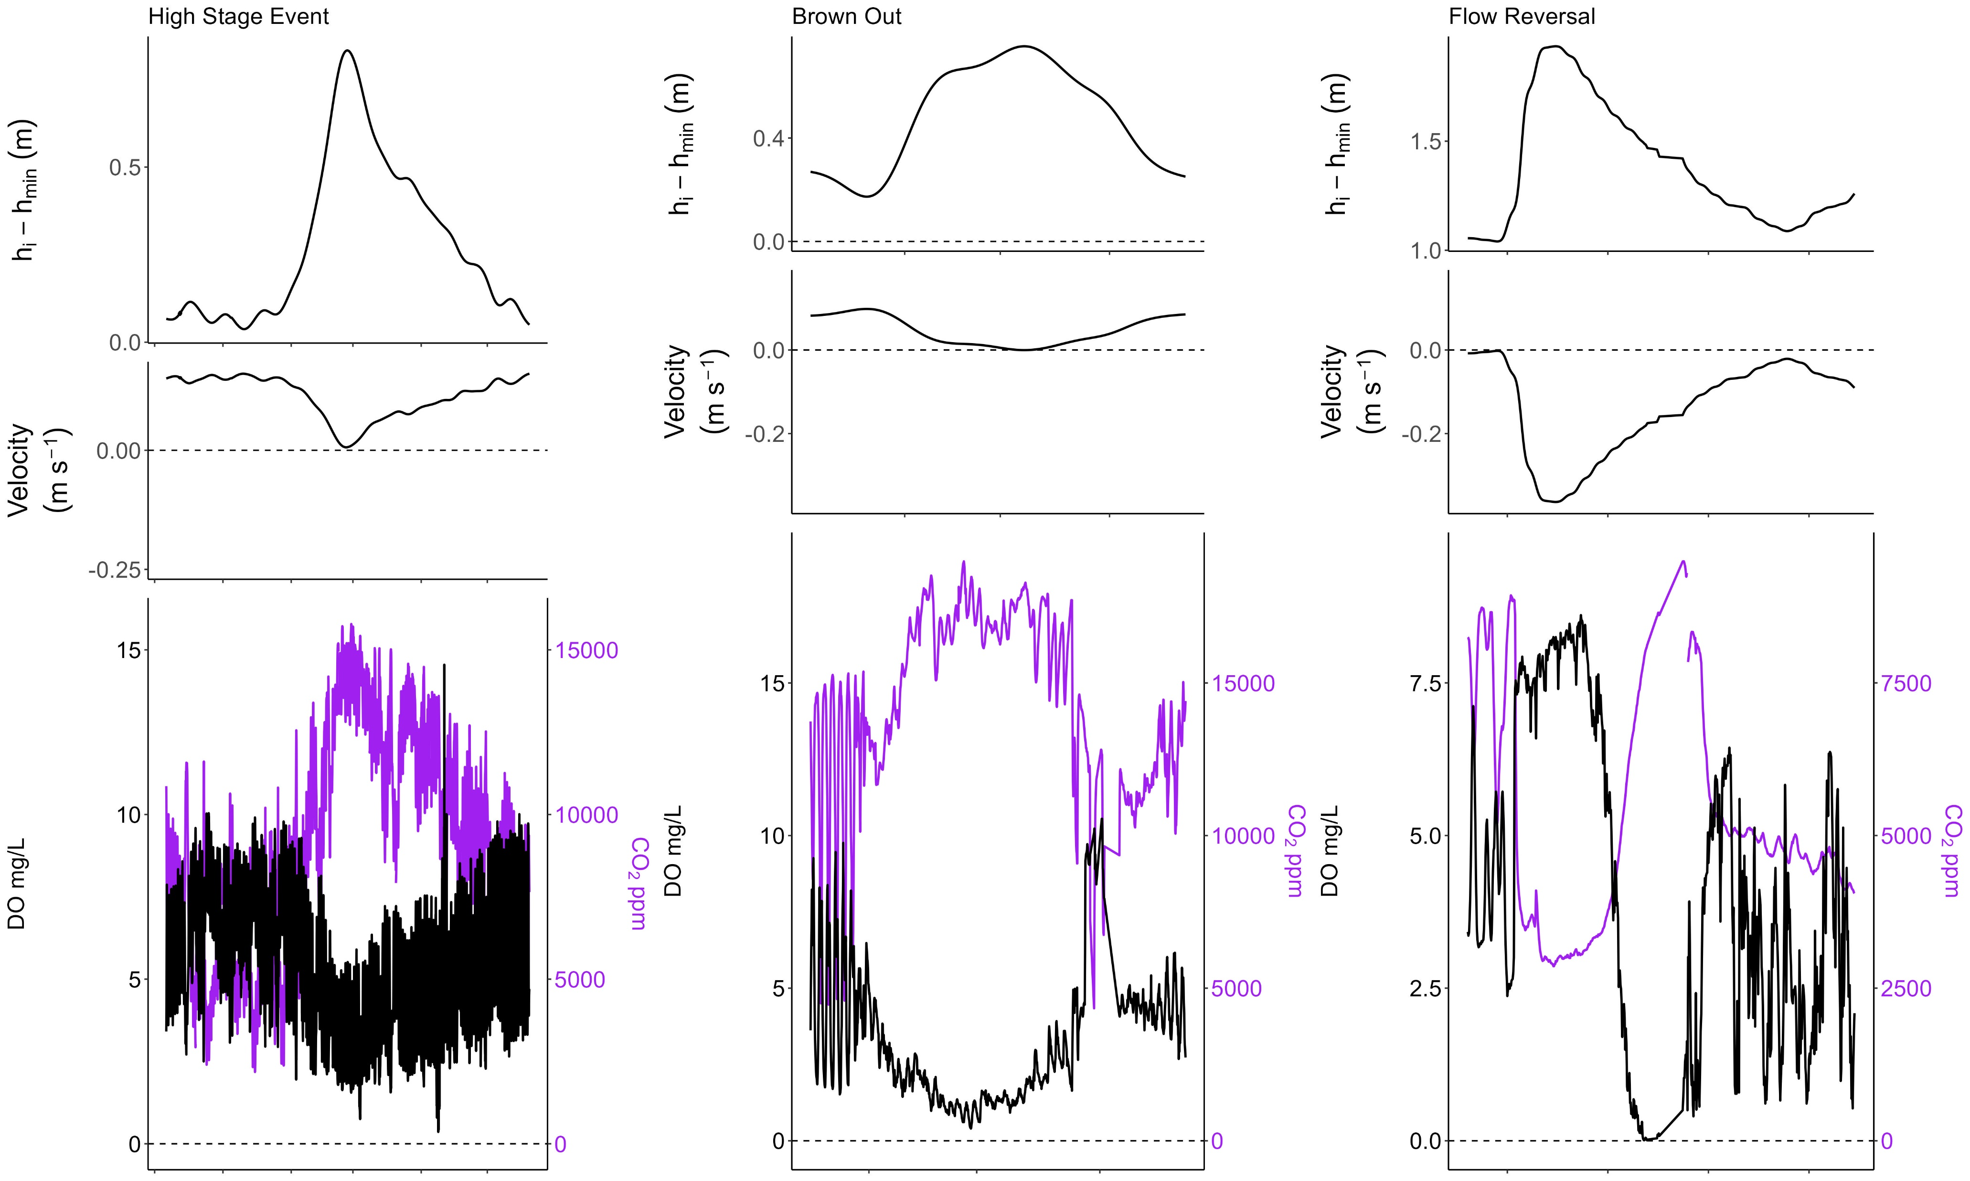
Dissolved oxygen (DO) decreased, and CO2 increased with increasing stage. River reversals caused hypoxia.
H1. Spring-run productivity will decline during floods, despite the absence of bed scour
Notes:
Before any modeling, a pattern emerged between stage, CO2, and DO.
For every flood, as stage increased, DO decreased and CO2 increased in tandem displaying strong coupling.
AND The degree in which DO, and CO2 changed aligned with each flood's magnitude.
For instance, during high stage events, O2 decreased, and CO2 increased with increasing stage.
For every river reversal, again, there is a fall in DO and an increase in CO2, but the spring-run became hypoxic whether a brownout (mixing) or a flow reversals (displacement).
However, during a flow reversal, at the height of each disturbance, DO spikes and then dramatically falls. This an indicator of a true flow reversal. The river has higher DO concentrations than the groundwater-fed spring. The spike is the moment in which river water displaced spring water at the sensor's location.

Slide 13
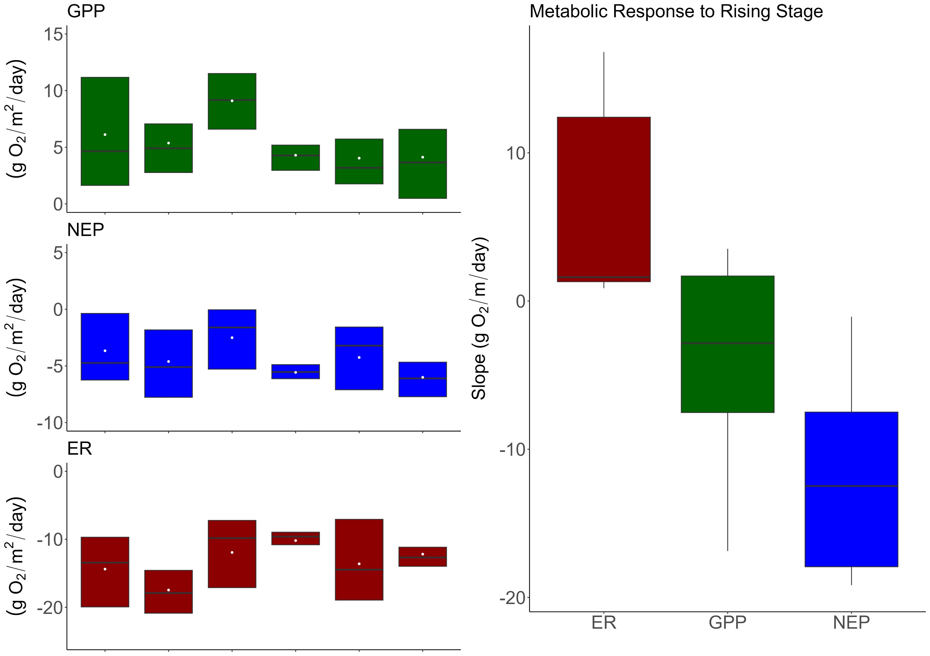
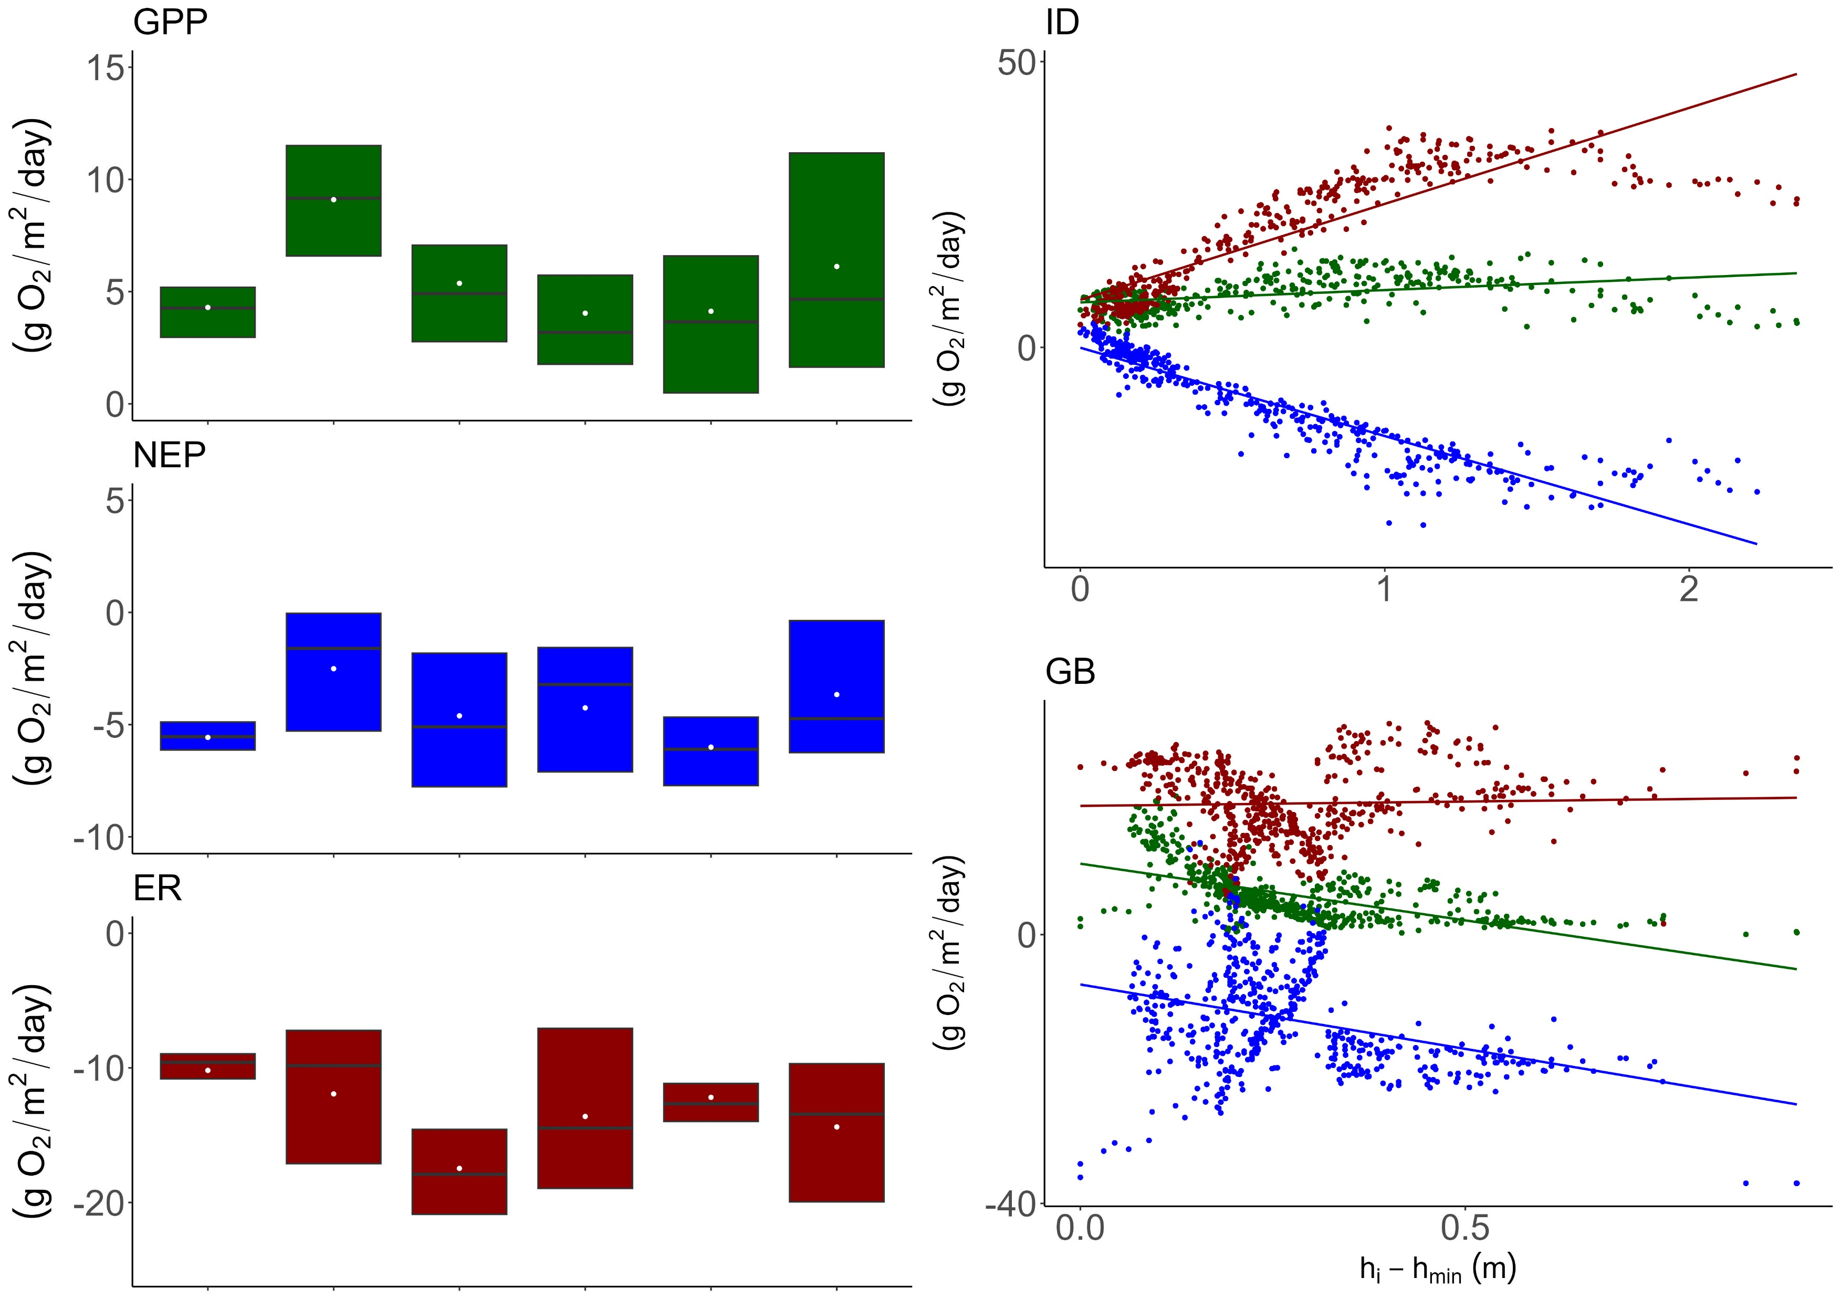
Stage and productivity have a negative relationship.
H1. Spring-run productivity will decline during floods, despite the absence of bed scour
Notes:
Moving on, here are the stream metabolism results across sites including disturbed and non disturbed periods.
Most of my sites were heterotrophic with LF and AM being the exception. They are exceedingly productive.
CLICK
On the left is a scatter displaying the metabolic response to rising stage for two of my sites, one rarely flooded and a moderately flooded site. Like DO, as stage increased, GPP decreased, and ER increased.
This significant trend can be seen across all the sites resulting in a decrease of net ecosystem productivity (NEP)
CLICK
In short, when stage rose, productivity fell, regardless of disturbance regime indicating depth and flow are significant factors in spring metabolic regime.

Slide 14
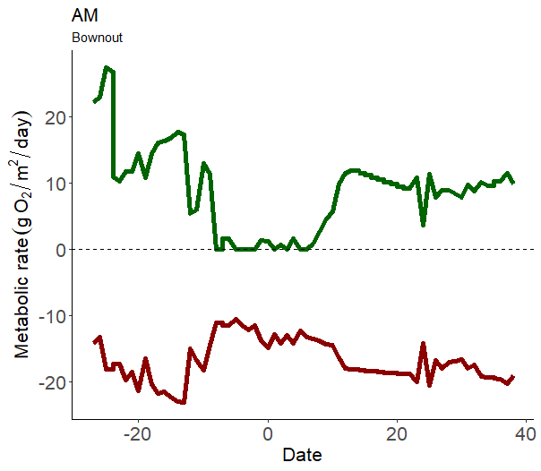

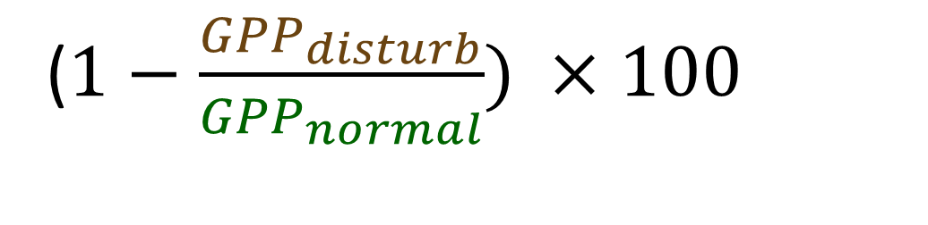
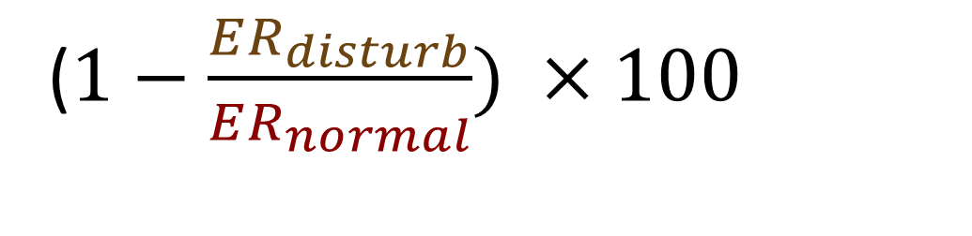
Is disturbance magnitude correlated with spring-run metabolic degradation?
Percent Reduction:
($1−\frac{{GPP}_{disturb}}{{GPP}_{normal}}) ×100$
($1−\frac{ER_{disturb}}{ER_{normal}}) ×100$
Cite AJ
Notes:
Zooming in, I wanted to explore whether the severity of disturbance impacts was dependent on spring disturbance magnitude.
Using simple percent-reduction equations

Slide 15
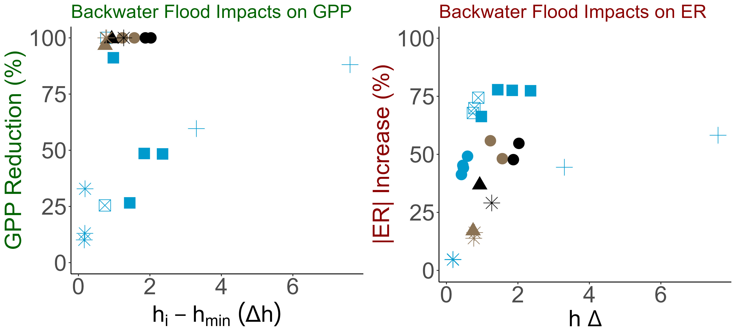
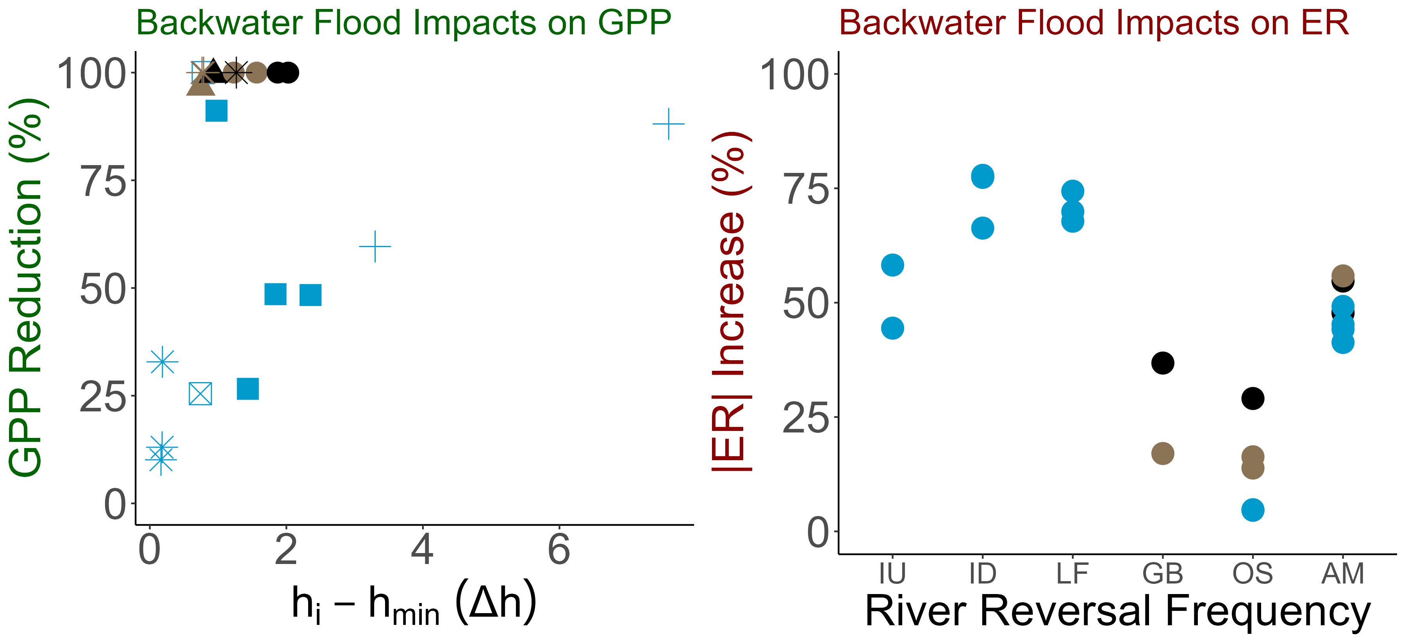

, ER tended to increase with increasing stage. River reversals drove GPP to 0.
H2. Flood magnitude will be positively correlated with metabolic recovery time and metabolic reduction.
ER increases
GPP decreases
Acuna et al., 2004; Reisinger et al., 2017
Notes:
In this figure, the x axis represents the difference between the stage minimum and the flood stage.
On the y axis I have the percent reduction
Once water become brown, GPP was diminished, regardless of flood magnitude CLICK
As or high stage events, GPP and stage have a negative relationship with GPP decreasing with an increase in stage. CLICK
As for ER, ER did not increase with disturbance magnitude but did have a positive correlation with stage. Although this trend is insignificant, as stage increased, ER tended to increase.
CLICK There seems to be some clustering among sites but it seems minimal
Overall, river reversals drove GPP to 0 while ER tended to increase with increasing stage.

Slide 16
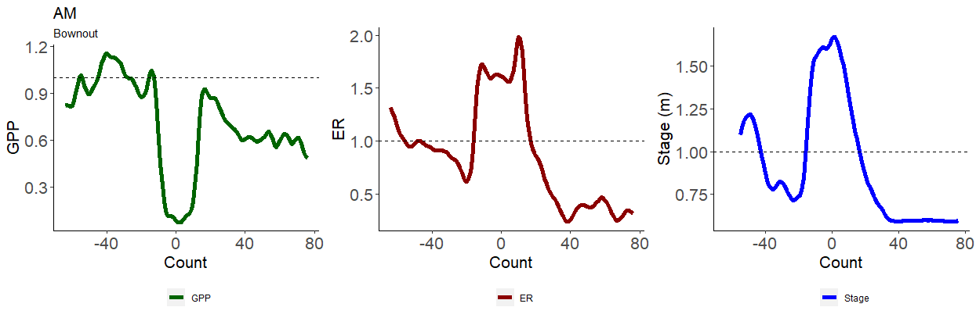
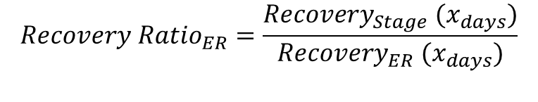
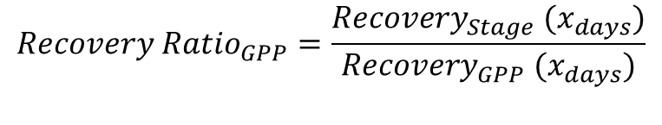
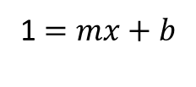
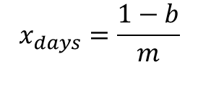
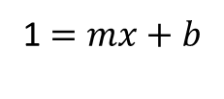
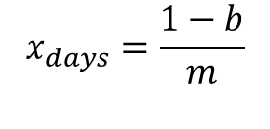
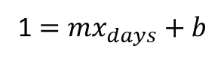
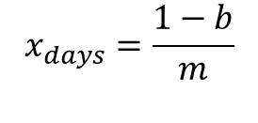
Is disturbance magnitude correlated with spring-run recovery?
$$x_{days}=\frac{1−b}{m}$$
$$x_{days}=\frac{1−b}{m}$$
$$x_{days}=\frac{1−b}{m}$$
1 $=mx_{days}+b$
1 $=mx+b$
1 $=mx+b$
$$Recovery Ratio_{GPP}=\frac{Recovery_{Stage} (x_{days})}{Recovery_{GPP} (x_{days})}$$
$$Recovery Ratio_{ER}=\frac{Recovery_{Stage} (x_{days})}{Recovery_{ER} (x_{days})}$$
Recover Ratio > 1; Metabolism recovered quicker.
Recover Ratio < 1; Stage recovered quicker .
Reisinger et a. 2017.
Notes:
Continuing this thread, a spring’s recovery dependent on disturbance regime or disturbance magnitude, or both?
For this, I fitted a linear regression between the height of the disturbance and when the spring-run recovered
I extracted this linear relationship to estimate recovery time
I divided GPP and ER recovery by stage’s recovery and called these ratios, recovery ratios

Slide 17
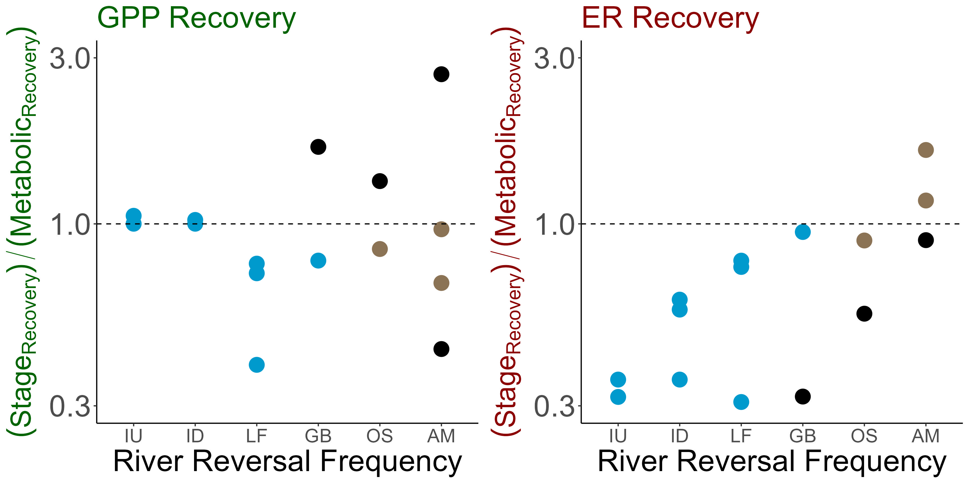
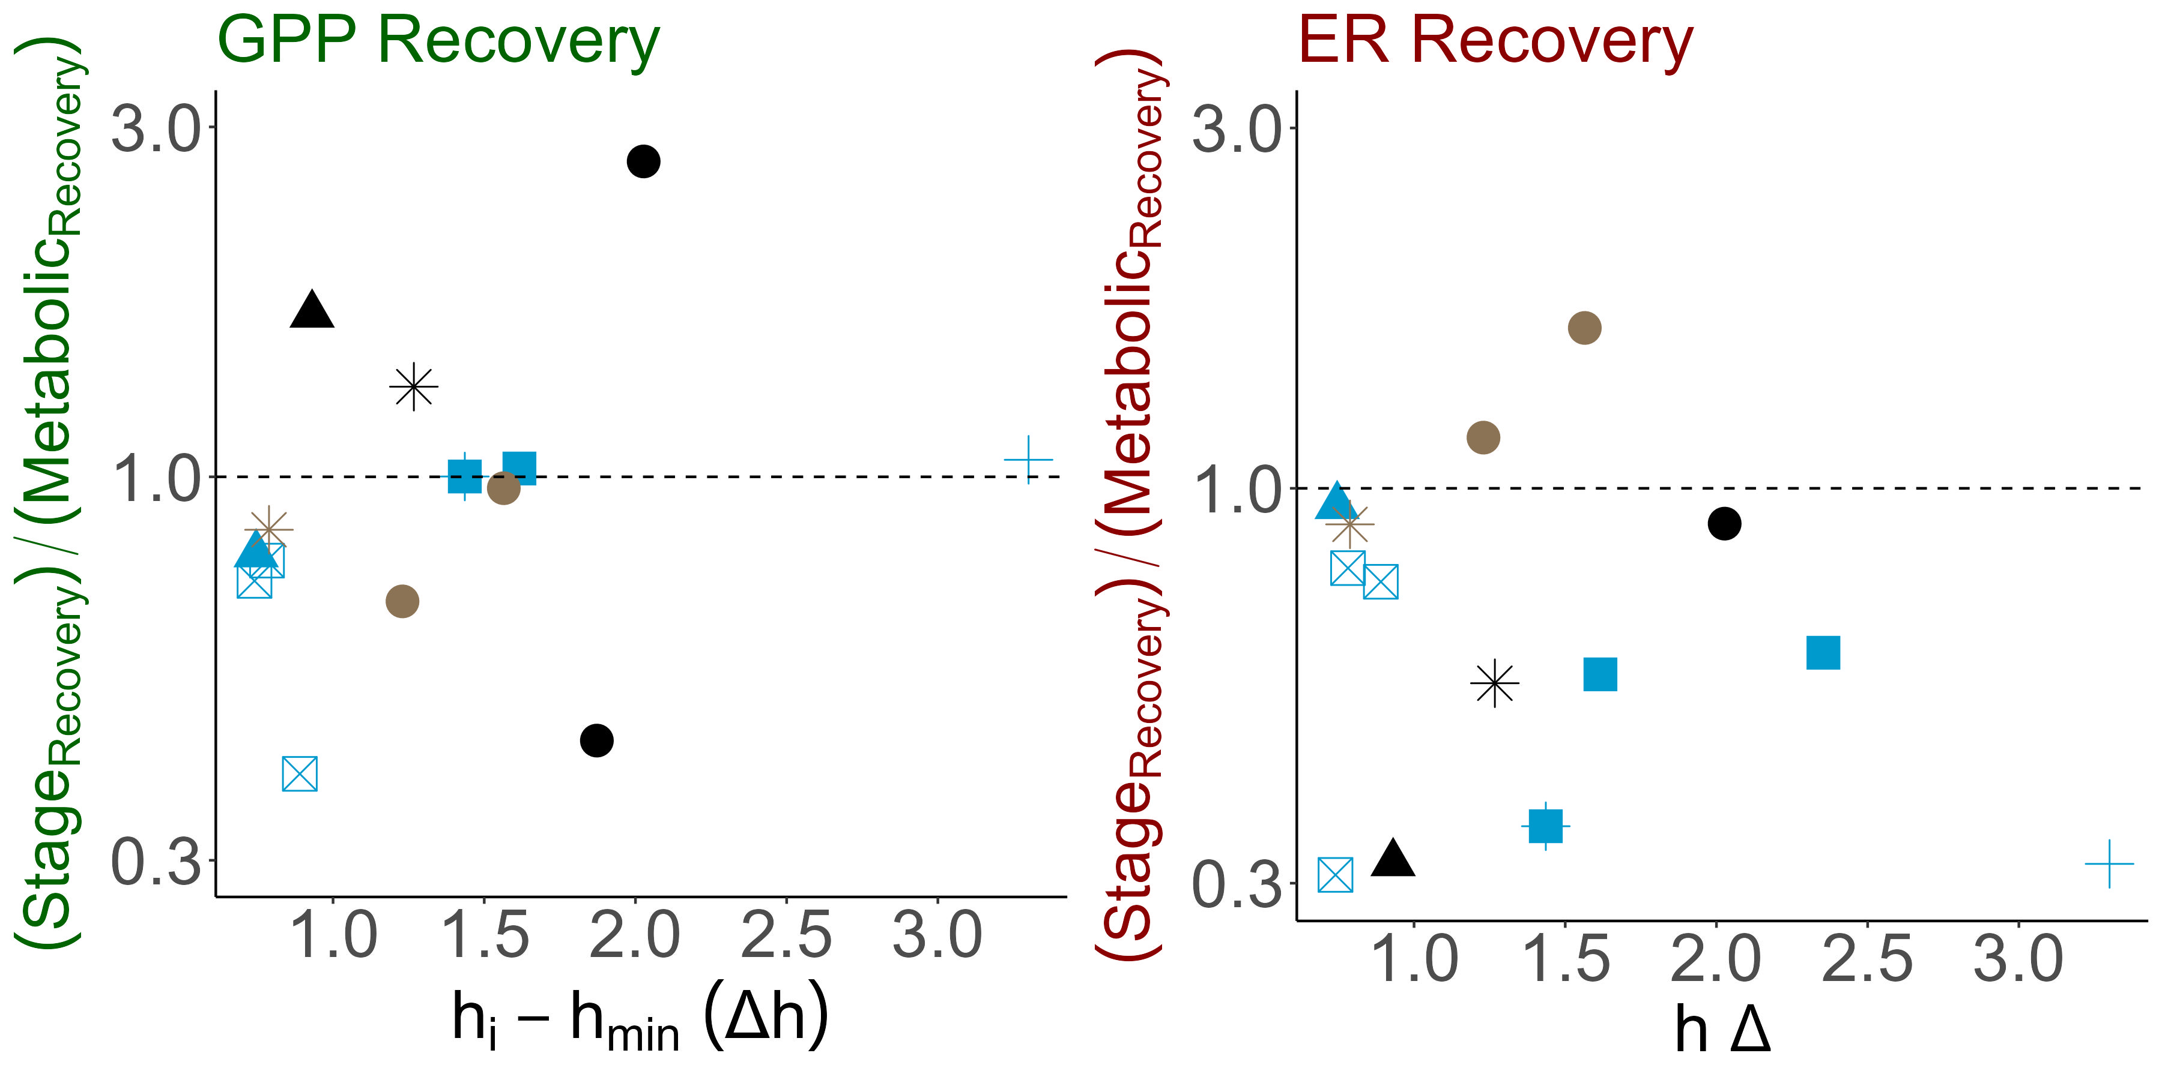
Spring metabolism recovered alongside or quicker than stage. ER recovered more quickly in more disturbed springs, and GPP took longer to recover with increasing stage.
H2. Flood magnitude will be positively correlated with metabolic recovery time.
Reisinger et a. 2017.
Notes:
In most cases, both GPP and ER recovered along-side, or more often, slower than stage.
CLICK
From these observation the more severe the flood, the longer it took for stage to recover while metabolism often rebounded quickly
This positive trend is seen clearly seen in GPP. CLICK For ER, the trend is less distinct…BUT CLICK
A clear positive relationship is seen with disturbance regime. The more disturbed the site, the quicker ER was able to rebound.
Like disturbed urban streams, frequently flooded and reversing spring-runs may have adapted to their fluctuating flow regimes, allowing for productivity under less-than-ideal conditions CLICK
GPP did not have any obvious relationships with disturbance regime but none the less… click

Slide 18
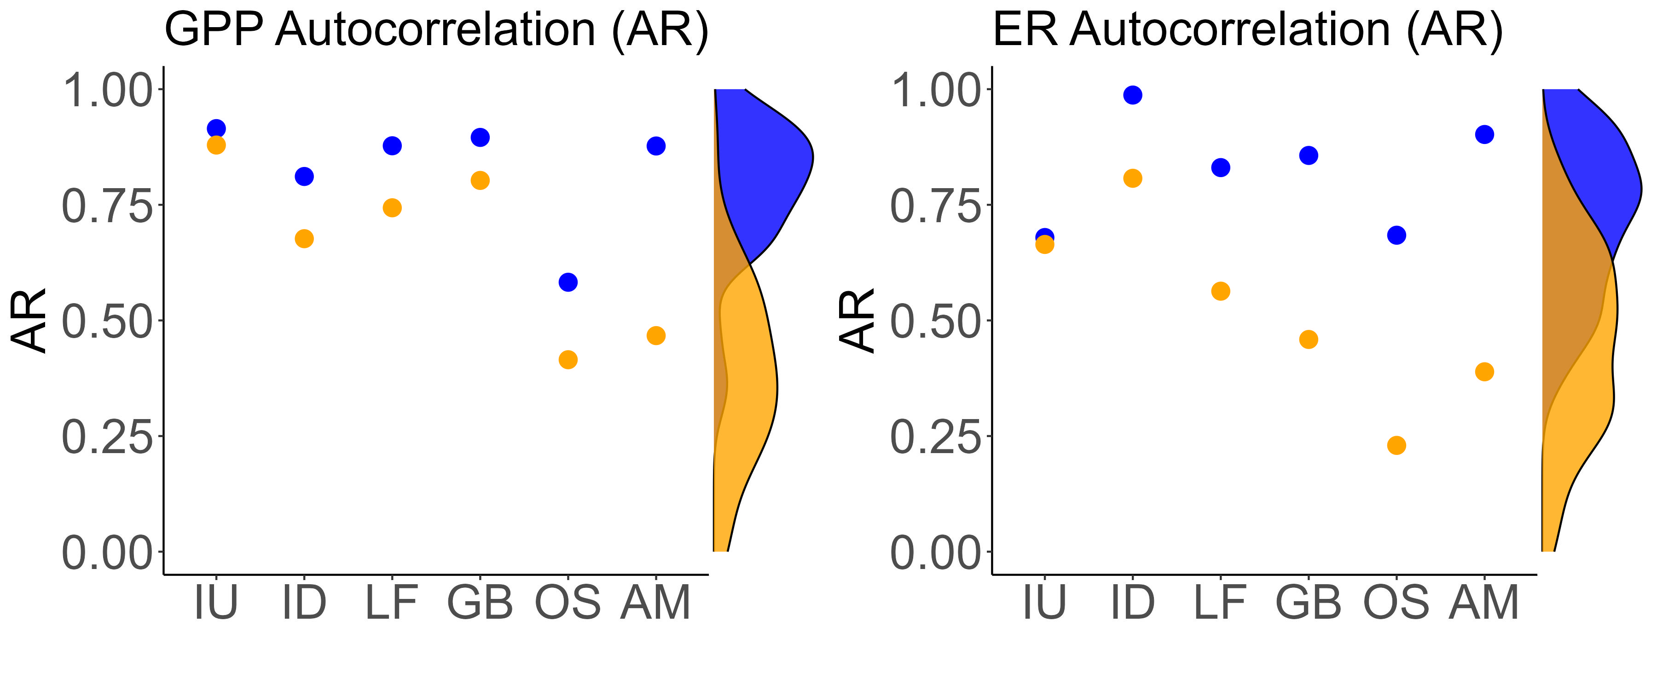

Less disturbed spring-runs had more stable metabolic regimes than more disturbed spring-runs.
H3. Frequently disturbed springs will have less stable metabolic regimes than rarely disturbed springs.
Notes:
Lastly, with these results in mind, I wanted to investigate whether more disturbed springs displayed less metabolic stability during normal, non-flooded periods then less, more stable-flowing springs.
Here I present the autocorrelation for each of my sites. The density data on the site is from Appling et al. 2020, displaying the autocorrelation for ~50 flowing waters.
My site followed the expected pattern with less disturbed sites having greater autocorrelation than more disturbed sites.
Furthermore, these springs CLICK belonged to the upper half of the Appling’s more correlated springs, even sites that spend half the year reversed.

Slide 19


Indicating light availability is a major factor in spring-metabolism
H1. Spring-run productivity will decline during floods, despite the absence of bed scour
H2a. Flood magnitude will be positively correlated with metabolic recovery time.
Bernhardt et al. 2018; Mullholand et al. 2001; Hensley et al. 2017; Uehlinger et al. 2000; Donsky 2023
Notes:
This paints a unique picture of spring-run metabolic regime
Increasing stage was significantly correlated with a decrease in productivity. CLICK
However, once light was extinguished by a river reversal, GPP became 0 regardless of flood magnitude CLICK
Indicating light availability is a major factor in spring metabolism.
If light is attenuated, the spring-run will have a metabolic response. Furthermore, for river reversals, the swapping of headwaters is not important. If the run is shaded by tannic water, whether it be 100% river water or a mix, spring productivity will halt.

Slide 20
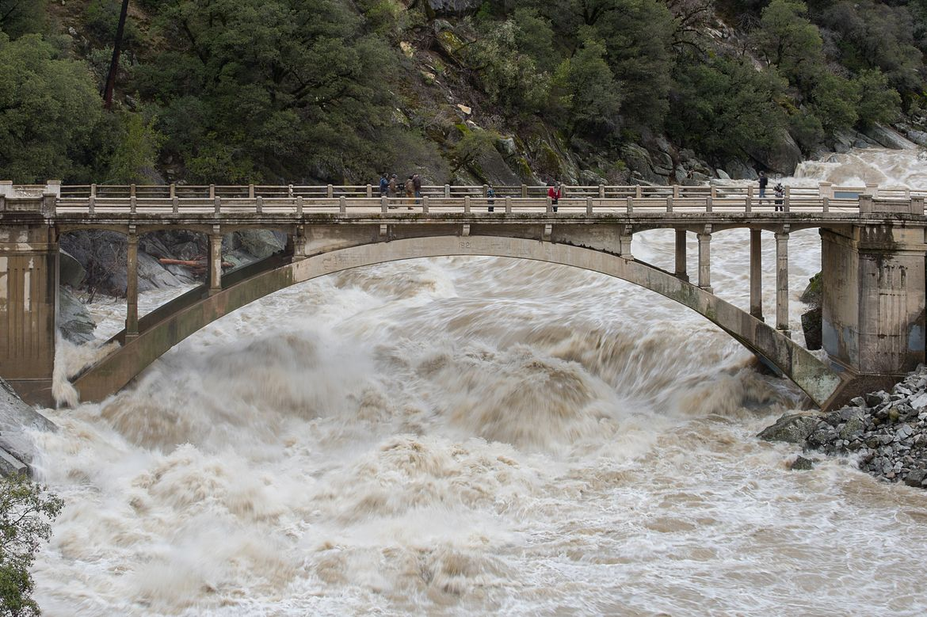

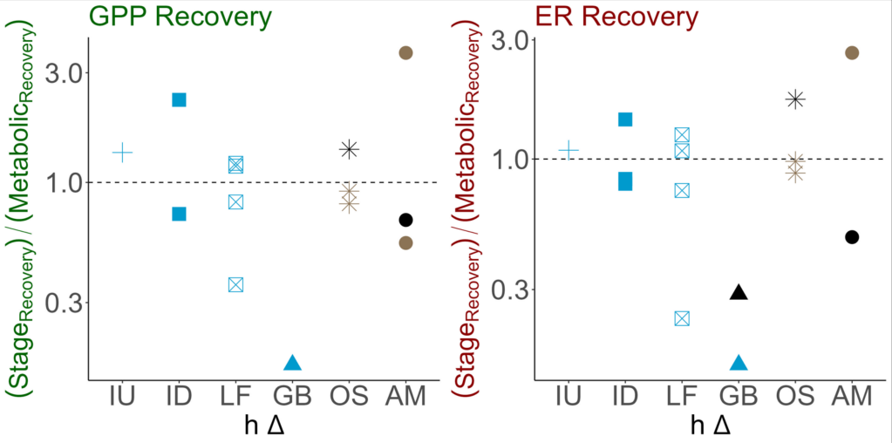
Light availability determines productivity, but the degree of bed scour the decides rate of recovery
H2b. Flood magnitude will be positively correlated with metabolic recovery time and metabolic reduction.
H3. Frequently disturbed springs will have less stable metabolic regimes than rarely disturbed springs.
Notes:
Yet, spring metabolism often recovered faster or along side stage. CLICK
Additionally, these sites GPP and ER were more correlated than average flow waters.
This may result may be due to the absence of bed scour during floods. CLICK
Since the spring-runs retain their benthos, once light returns, they can immediately begin photosynthesizing allowing their metabolism to recover quickly.
If this is true, light may be a determining factor in flow waters metabolism but its bed scour that decides disturbance recovery.

Slide 21

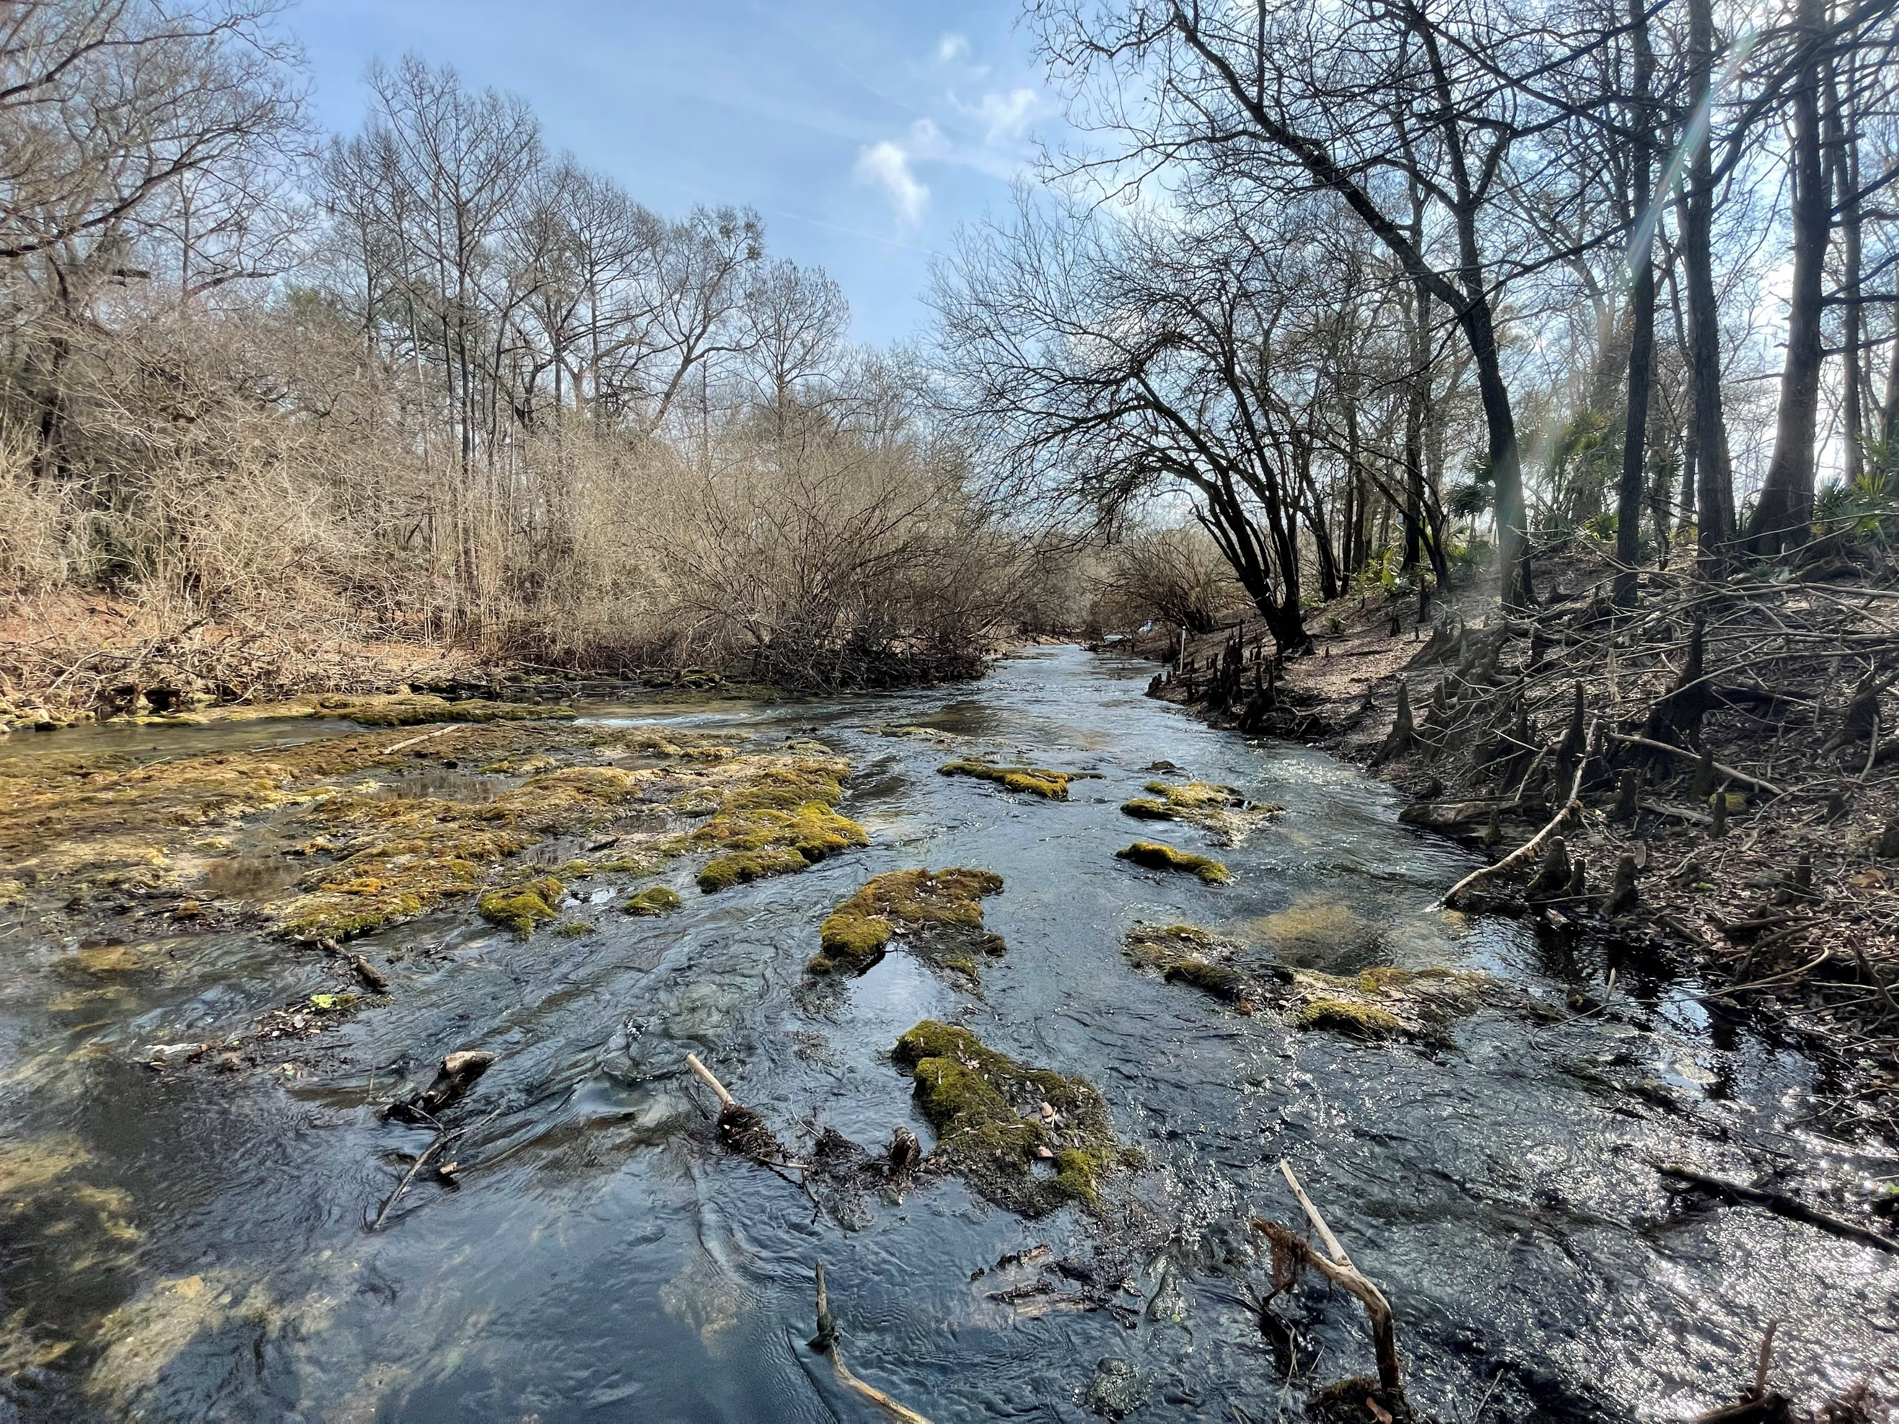
H3. Frequently disturbed springs will have less stable metabolic regimes than rarely disturbed springs.
Ichetucknee Headspring
Allen Mill Pond
Rum Springs
Metabolic Stability
Notes:
And lastly, I found North Florida spring-runs span a gradient of flow regimes dependent on their disturbance regime where some springs flood and others do not

Slide 22




































































… and as such, disturbance is a key factor in spring-run regime and function
CO₂
CO₂
CO₂
CO₂
Thank you!
samanthahowley@ufl.edu
CO₂
CO₂
CO₂
CO₂
CO₂
CO₂
CO₂
CO₂
Notes:
And as such, disturbance is a key factor in spring-run metabolic regime and function, like any other flowing waters
Thank you!

Slide 23
Appendix

Slide 24
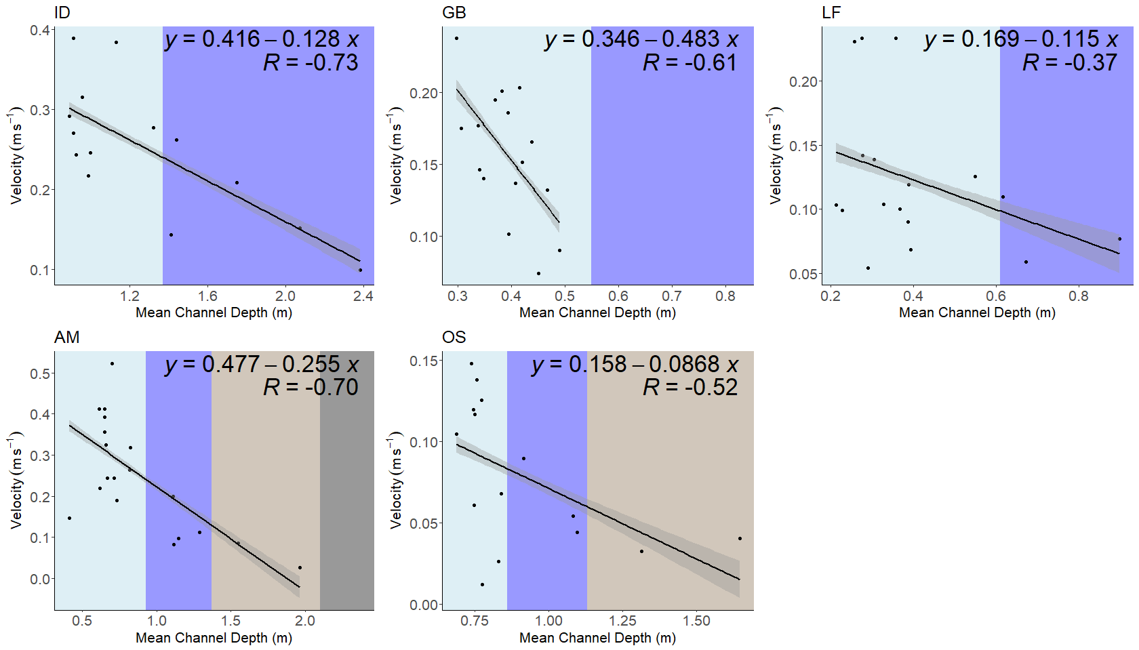


Slide 25
